Slide 1



8-bit RISC 5-STAGE PROCESSOR ARCHITECTURE
Presentation Roadmap
Project Overview
Architectural Datapath Overview
PROJECT NAME
RISC-8 5-Stages Pipeline Processor
STUDENT NAME
RTL Schematic Optimization
[HOÀNG NGỌC LONG]
STUDENT ID
[SE204586]
Pipeline Hazards & Resolutions (Code)
STATUS
Design & Simulation Phase Complete
Verification & Waveform

Slide 2

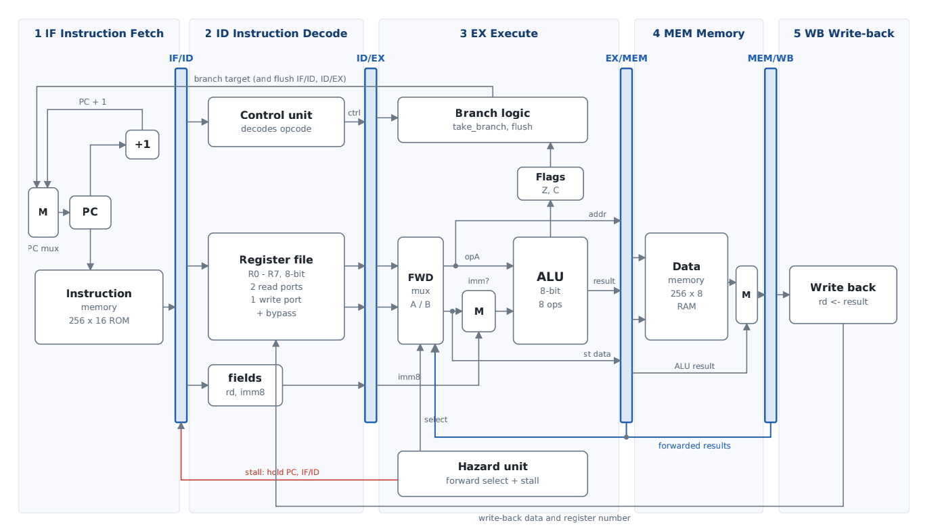
Datapath
Diagram
Complete data path through 5 independent hardware stages.
IF: Instruction Fetch.
ID: Instruction Decode.
EX: ALU Execute.
MEM: Memory Access.
WB: Register Write-back.

Slide 3

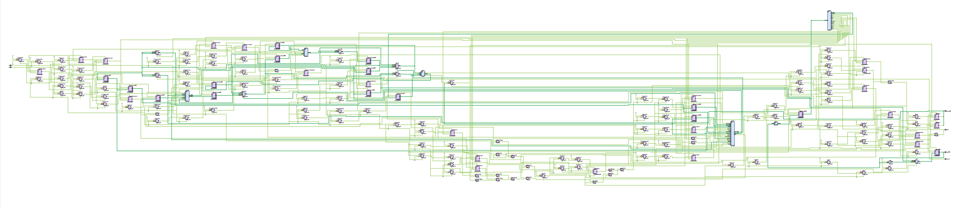
Modularization: Packaged into 7 core modules.
RTL Schematic Optimization
Keep Hierarchy: Preserved block structures.
Organizing the spider-web schematic into hierarchical blocks.
Clear Schematic: 100% match with theory.

Slide 4



Hazard Classification
Pipeline conflicts requiring hardware intervention.
Data Hazard
Load-Use
Control Hazard
Register data not yet written back.
Memory read delay stalls pipeline.
Taken branch invalidates fetch.
Resolution: Forwarding Mux
Resolution: 1-Cycle Stall
Resolution: Branch Flush

Slide 5
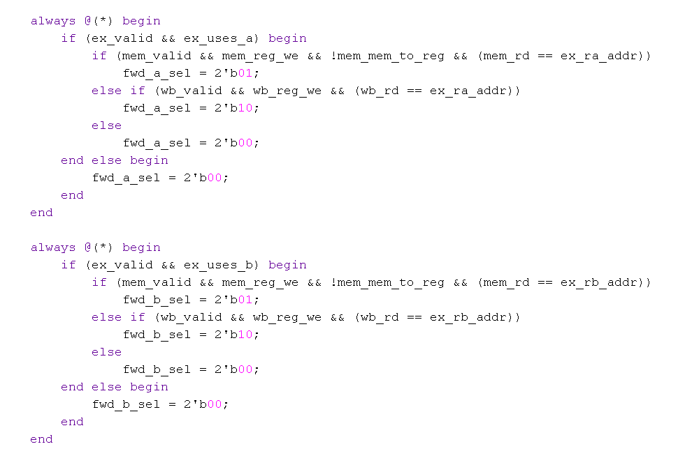
Data Forwarding Implementation
Routing fresh ALU results backward to bypass outdated register reads.
Check uses_a / uses_b.
Compare source vs destination.
Priority 1: EX/MEM stage.
Priority 2: MEM/WB stage.

Slide 6
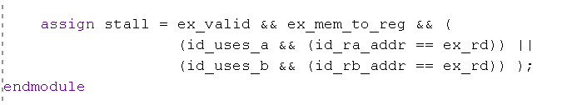
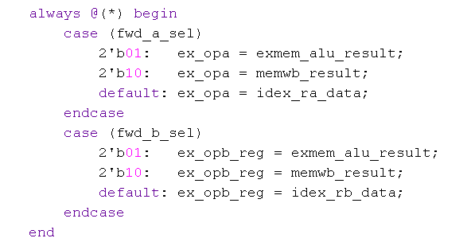
Load-Use Stall Condition
Load-Use Stall & Resolution Logic
Handling memory delay through 1-cycle stalling and data forwarding.
ALU Operand Forwarding Mux
Identify LD instruction in EX.
Check dependency in ID stage.
Freeze PC and IF/ID registers.
Inject NOP bubble into ID/EX.

Slide 7
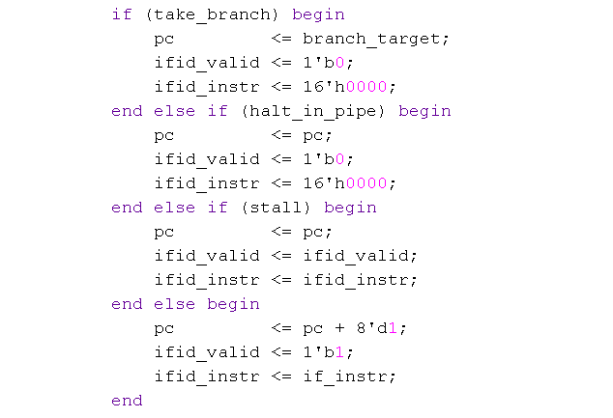
Branch Flush Execution
Discarding wrong-path instructions upon branch resolution.
Branch condition calculated in EX.
PC jumps to target address.
IF/ID buffer cleared (valid = 0).
ID/EX buffer cleared (valid = 0).

Slide 8
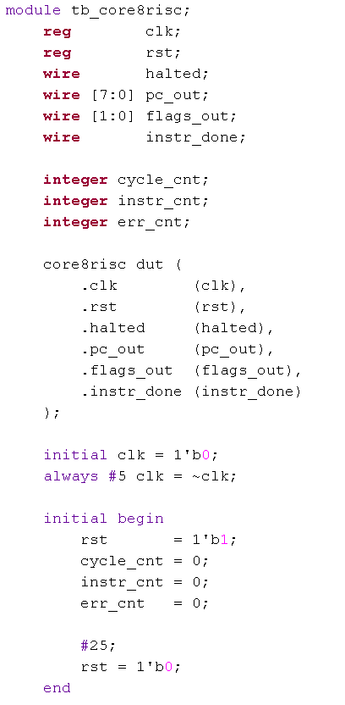
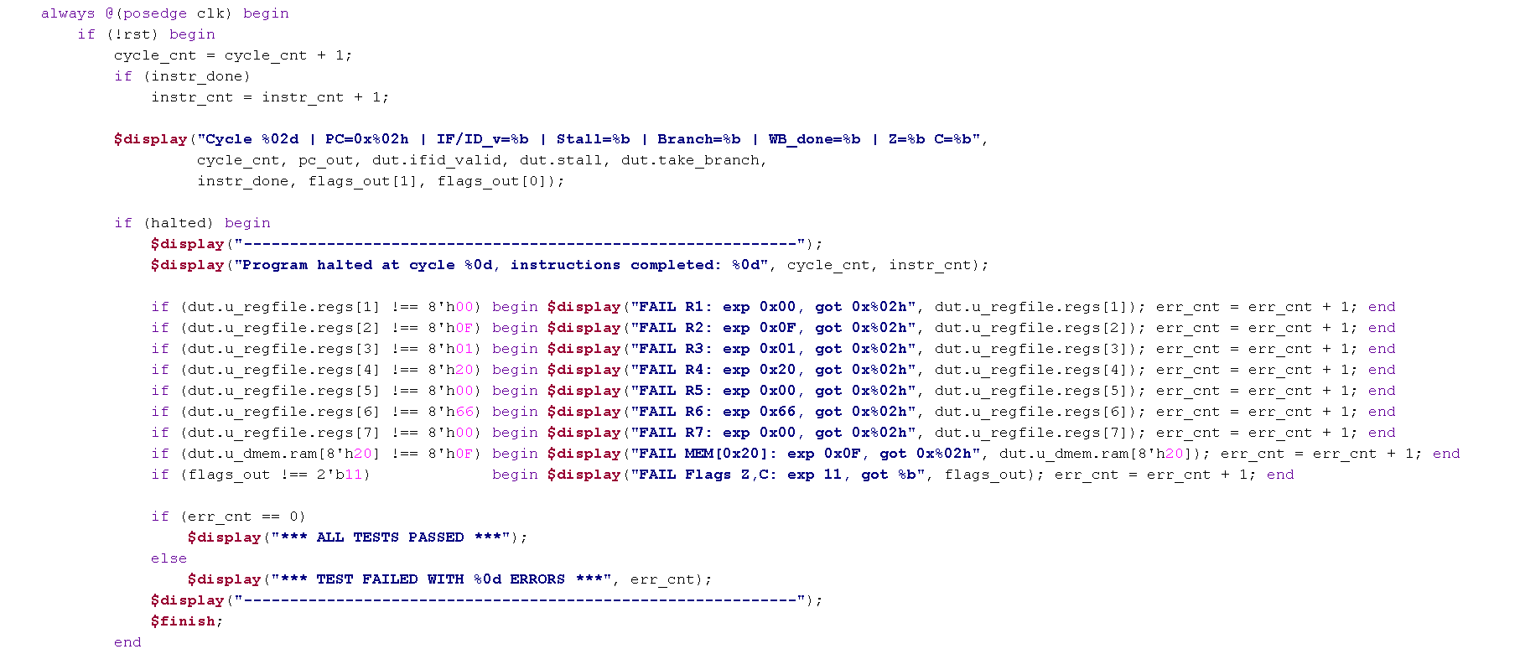
Testbench & Self-Checking Verification Architecture
Automated stimulus generation, clocking, and regression checking.
Initialization & DUT Instantiation
Monitoring & Self-Checking

Slide 9
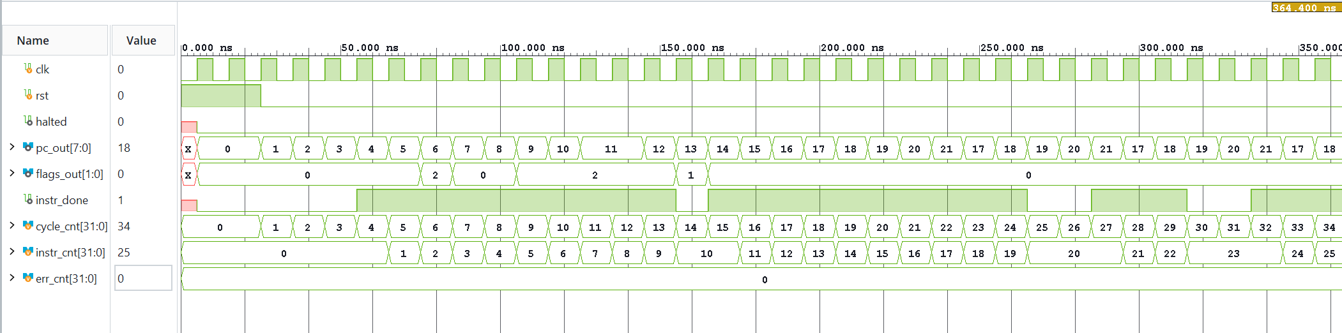

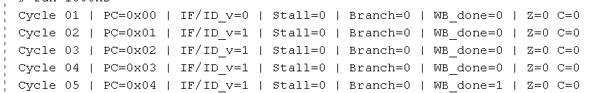
Simulation & Waveform
Pipeline Filled
PC Branch Flush
Zero Logic Errors
Continuous completion after cycle 4.
PC steps back correctly during BNZ.
Error counter remains at zero.

